Slide 1
ATM Fraud Detection System
MAHARAJ VIJAYARAM GAJAPATHI RAJ COLLEGE OF ENGINEERING
MAJOR PROJECT Group Number-13
BY:
GUIDE:
Dr. D. Rama Devi M.Tech , Ph.D. Professor & HOD Department of ECE
23335A0414- P.SIVA SAI KRISHNA
22331A04H0-T.VARSHITHA
22331A04H6-V.BHARGAV
22331A04F3-S.DILEEP

Slide 2
CONTENTS
S. No. | Title
1 | Abstract
2 | Project Overview
3 | Project Status – Phase-1 Completion
4 | Software Work Completed
5 | Software Implementation Output (Fig. 1), (Fig. 2)
6 | Hardware Components Procured (Fig. 3)
7 | Hardware Expenditure (TB.1)
8 | System Architecture (Fig. 4)
9 | Proposed Workflow (Fig. 5)
10 | Work Completed vs Remaining Work (TB. 2)
11 | Plan for Next Phase
12 | Conclusion
13 | References

Slide 3
ABSTRACT
ATM systems traditionally rely on card and PIN authentication, which are vulnerable to fraud if compromised. This project proposes a multi-factor ATM security system using RFID-based card verification, PIN authentication, and AI-based face recognition to enhance security. The system integrates Arduino-based hardware with a machine learning face recognition model implemented on a PC. Phase-1 of the project focuses on implementing the face recognition module, procuring required hardware, and establishing communication between hardware and software. The proposed approach aims to provide a low-cost, practical, and scalable solution for secure ATM access.

Slide 4
Project Overview
ATM frauds increasing due to stolen cards & PIN theft
Existing systems use single-layer security
Proposed system uses RFID + PIN + Face Recognition
Goal: Build a low-cost, practical ATM security prototype

Slide 5
Project Status – Phase-1 (30% Completion)
Literature survey completed
ML face recognition model implemented
Multi-user face dataset created
Arduino hardware procured
Serial communication tested (PC ↔ Arduino)
Initial integration completed

Slide 6
Software Work Completed
Face image capture implemented
Face encoding generation completed
Multi-user face recognition working
Accuracy tested using real-time webcam
Face recognition threshold tuned for stable accuracy

Slide 7
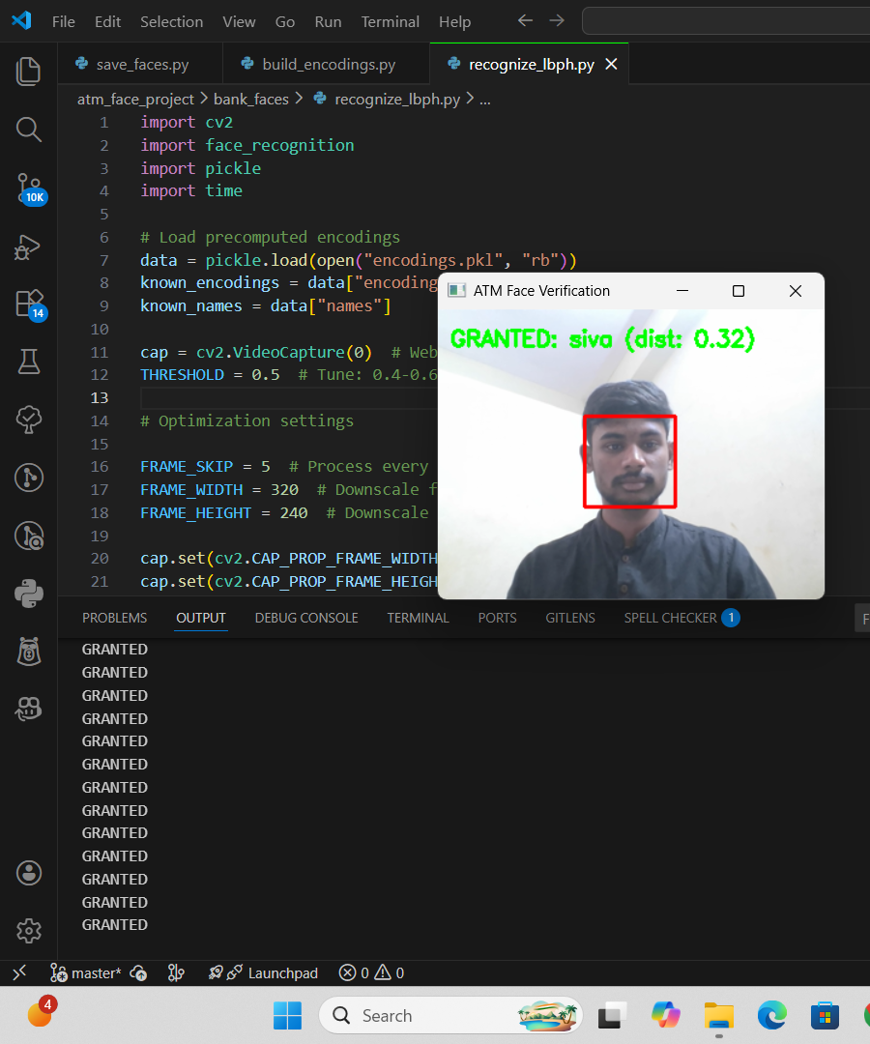
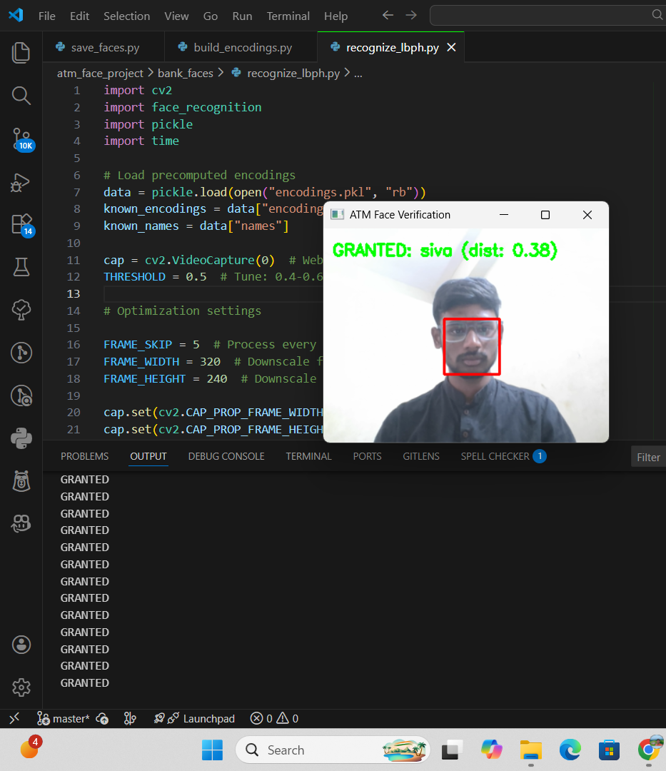
Software Implementation – Face Recognition Output
(Fig. 1)
(Fig. 2)

Slide 8
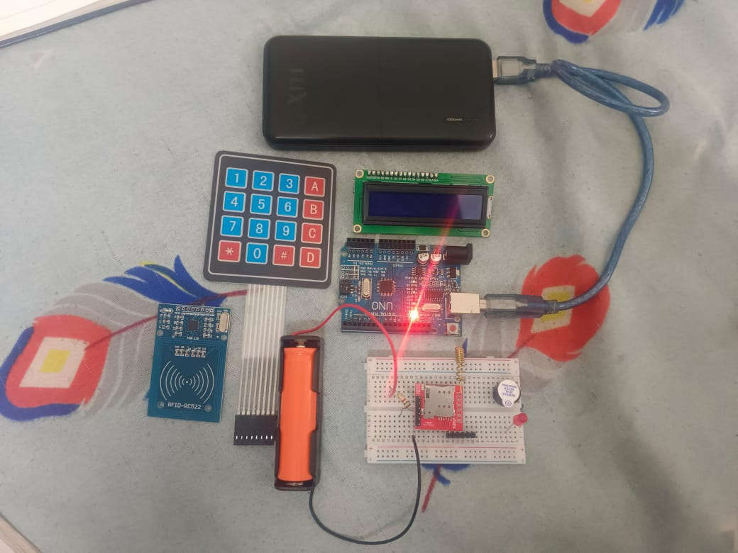
Hardware Components Procured
Arduino UNO
RFID RC522 + Tags
4×4 Keypad
16×2 I²C LCD
GSM Module (SIM800)
Buzzer
Jumper wires & Breadboard
(Fig. 3)

Slide 9
Hardware Expenditure Table
Component | Quantity | Cost (₹)
Arduino UNO | 1 | 550
RFID RC522 | 1 | 180
RFID Tags | 2 | 100
4×4 Keypad | 1 | 150
LCD 16×2 I²C | 1 | 225
GSM Module | 1 | 450
Buzzer | 1 | 25
Power Bank/Battery | 1 | 550
Wires & Breadboard | — | 120
Total |  | 2350
(TB.1)

Slide 10
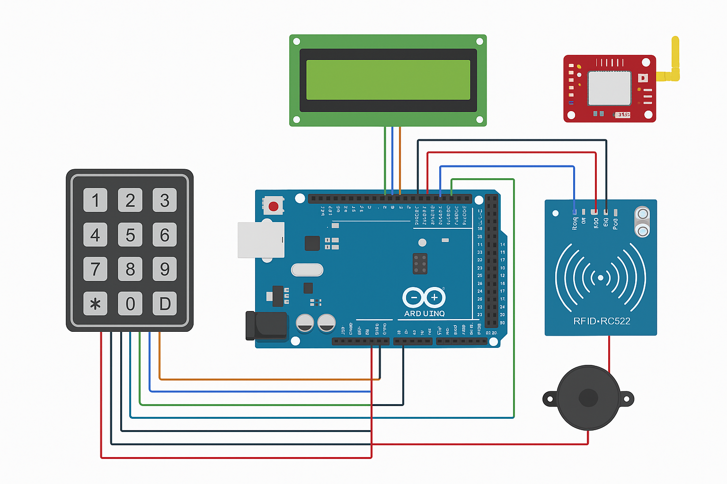
System Architecture (Block Diagram)
(Fig. 4)

Slide 11
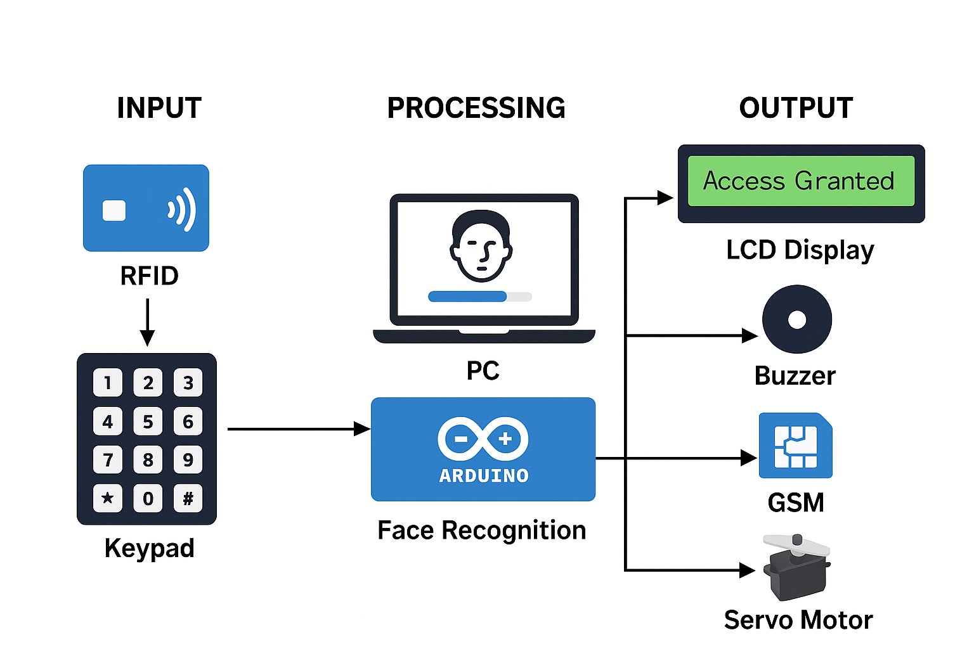
Proposed Workflow
1.Scan RFID
2.Enter PIN
3.Capture Face (8–10s window)
4.ML recognition (CNN/HOG)
5.If valid → Access Granted (servo open)
6.If invalid → Buzzer + GSM alert
(Fig. 5)

Slide 12
Work Completed vs Remaining Work
Completed | Remaining
Face recognition model | GSM alert testing
RFID + PIN logic | Full hardware integration
Arduino serial communication | Final demo
Dataset creation | Performance evaluation
(TB. 2)

Slide 13
Plan for Next Phase
Complete GSM alert integration
Full hardware prototype demo
Performance evaluation
Final documentation

Slide 14
Conclusion
Phase-1 objectives successfully completed
Hardware procured and tested
ML model implemented and verified
Ready for full system integration

Slide 15
References
A. Singh, R. Kumar, and P. Mehta,“Face Recognition Based ATM Authentication System,”IEEE International Conference on Intelligent Systems, 2019.
R. Sharma, S. Verma, and A. Gupta,“Smart ATM Security Using IoT and Biometrics,”IEEE International Conference on Communication and Computing, 2020.
P. Patel, N. Shah, and K. Joshi,“Deep Learning Based Real-Time Face Recognition for ATM,”IEEE International Conference on Artificial Intelligence and Signal Processing, 2021.
K. Verma, A. Mishra, and R. Singh,“IoT-Based Fraud Detection in ATM Machines,”IEEE International Conference on Internet of Things and Applications, 2022.
S. Reddy, M. Rao, and P. Kumar,“Multi-Factor Authentication in ATM Transactions,”IEEE International Conference on Secure Computing, 2023.

Slide 16
Thank You

